Slide 1
Exploring Financial Models

Slide 2
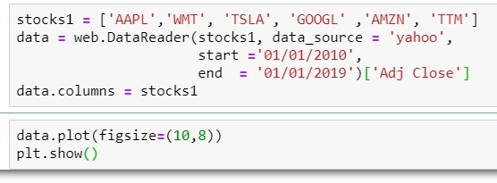
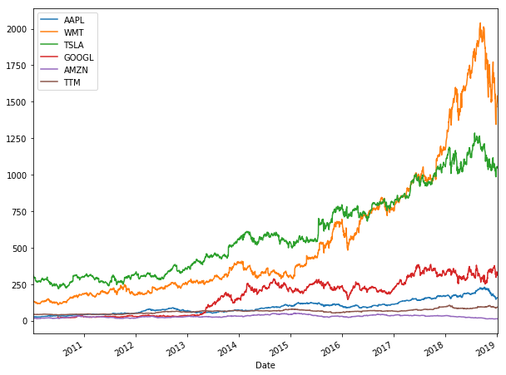
Modern Portfolio Theory (Markovitz Model)
Main idea:
A single stock is unpredictable, there’s no certainty whether it will go up or down.
Therefore we use the concept of ‘Diversification’: combine stocks to reduce risks as much as possible.

Slide 3
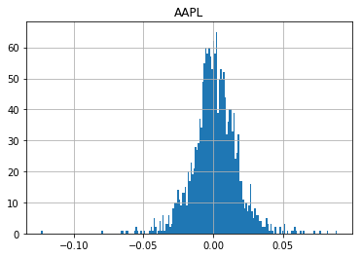
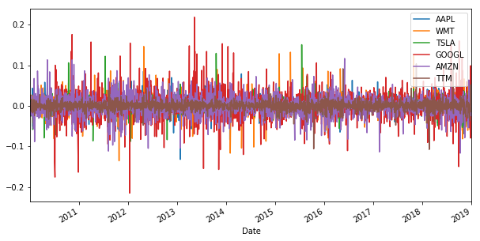
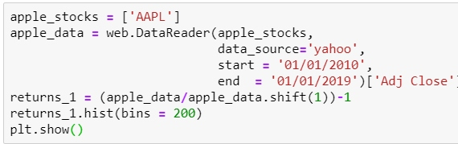

Assumptions:
Returns are normally distributed.
(returns are % increase in stock value from previous day)
Investors take more risk if they are expecting more rewards.

Slide 4
Goal:
To create an efficient portfolio:
Portfolio with highest return for a given level of risk.
Portfolio with lowest risk for a given return.
How to invest optimally in a portfolio?
APPL – 0.09 (9%)
WMT – 0.29 (29%)
TSLA – 0.04 (4%)
GOOGL – 0.21 (21%)
AMZN – 0.06 (6%)
TTM – 0.31 (31%)
Aim is to optimize these proportions to achieve the goal.

Slide 5
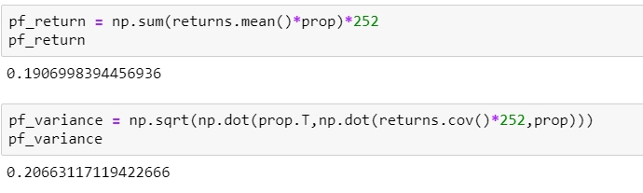
Expected Portfolio return and volatility (risk):

Slide 6
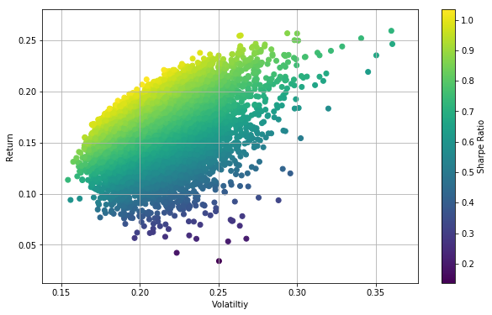
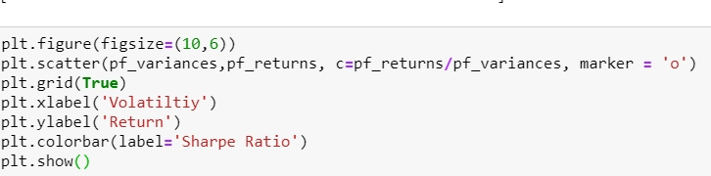
Run a Monte – Carlo algorithm and plot it using Scatter plot.
Coloured it by Sharpe Ratio that is the return/risk!

Slide 7

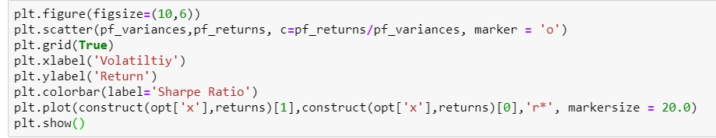
Maximize Sharpe ratio by optimizing the proportions in each stock.
Optimal proportion that maximizes Sharpe ratio is:
APPL – 0.31 (31%)
WMT – 0.33 (33%)
TSLA – 0.0 (%)
GOOGL – 0.10 (10%)
AMZN – 0.0 (0%)
TTM – 0.26 (26%)

Slide 8
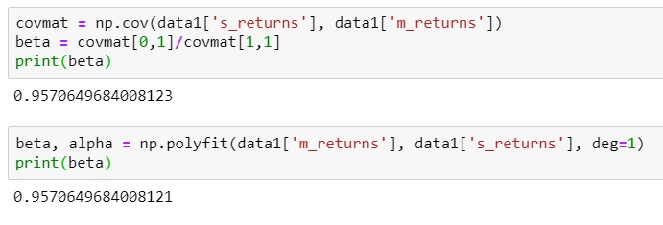
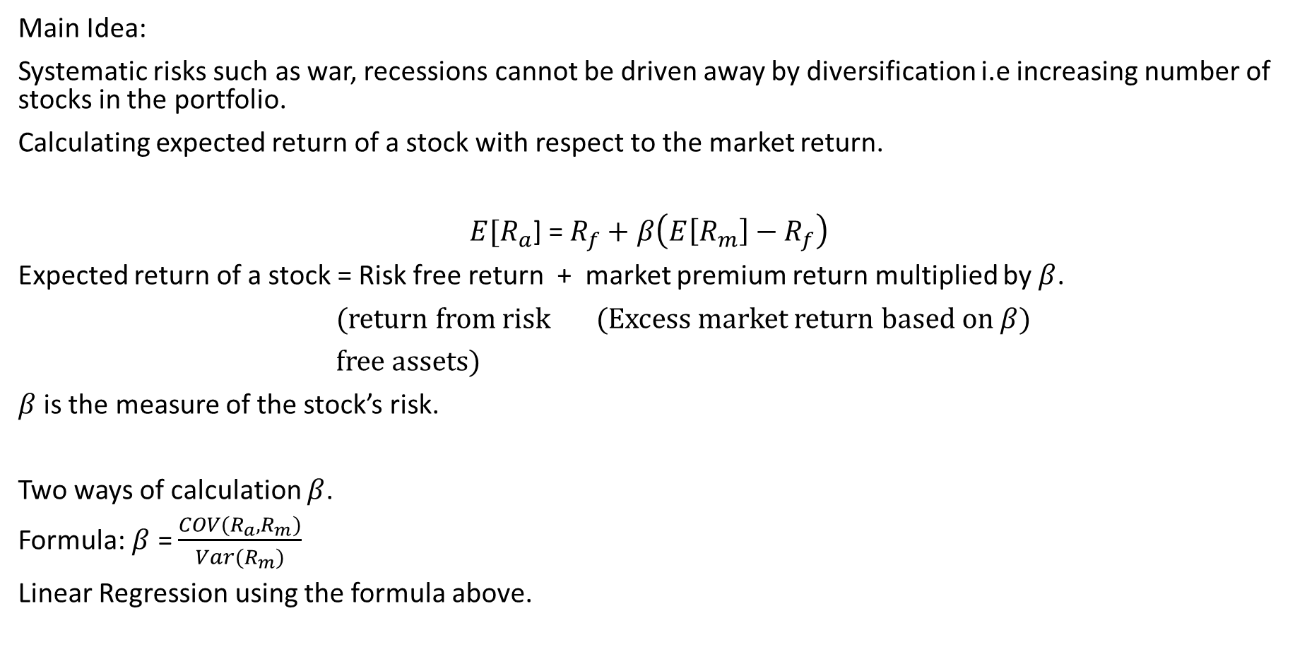
Capital Asset Pricing Model (CAPM)
Main Idea:
Systematic risks such as war, recessions cannot be driven away by diversification i.e increasing number of stocks in the portfolio.
Calculating expected return of a stock with respect to the market return.
$E[R_{a}$] = $R_{f}+$ $β\left(E\left[R_{m}\right]−R_{f}\right)$
Expected return of a stock = Risk free return + market premium return multiplied by $β$.
(return from risk (Excess market return based on $β$)
free assets)
$β$is the measure of the stock’s risk.
Two ways of calculation $β$.
Formula: $β$ = $\frac{COV(R_{a},R_{m})}{Var(R_{m})}$
Linear Regression using the formula above.

Slide 9
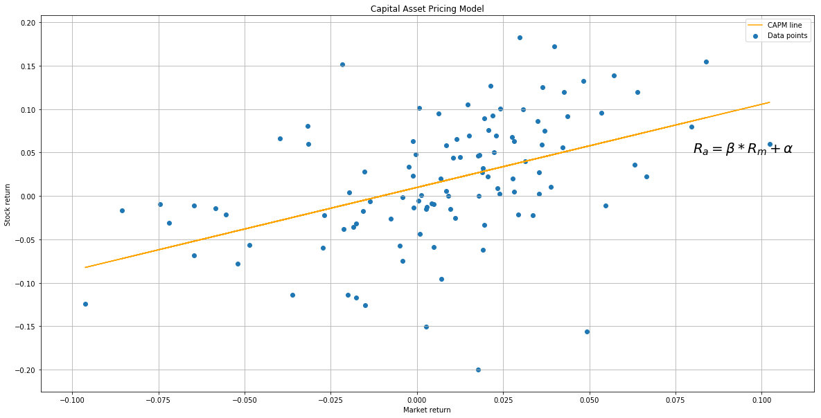
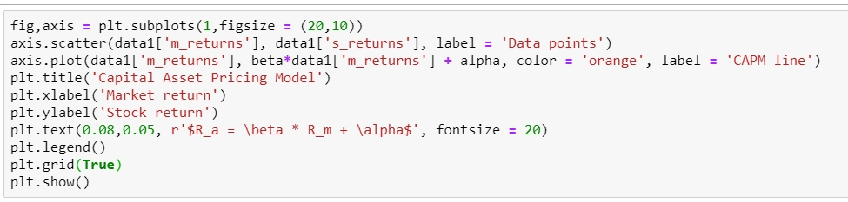
Plotting a scatter plot and regression line. (AAPL stock)

Slide 10
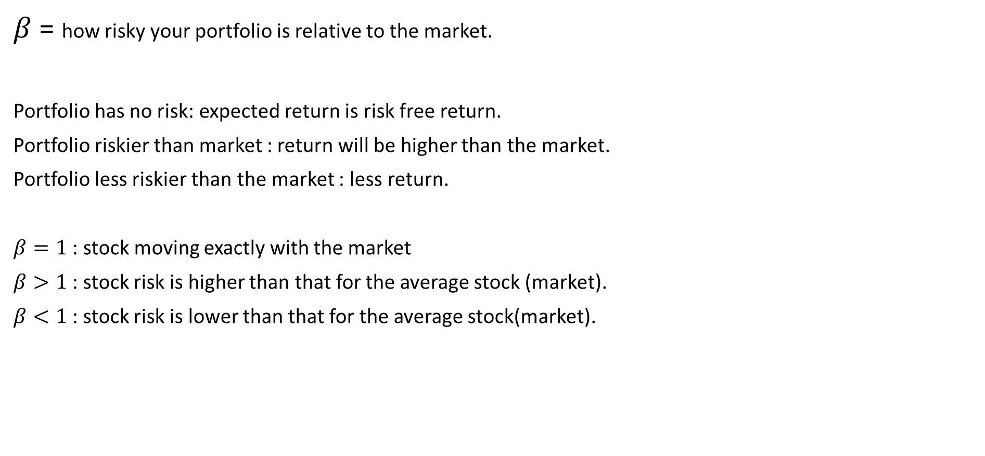

What does $β$ signify?
$β$ = how risky your portfolio is relative to the market.
Portfolio has no risk: expected return is risk free return.
Portfolio riskier than market : return will be higher than the market.
Portfolio less riskier than the market : less return.
$β=1$ : stock moving exactly with the market
$β>1$: stock risk is higher than that for the average stock (market).
$β<1$: stock risk is lower than that for the average stock(market).

Slide 11

Calculating expected return using the Beta calculated using regression. (AAPL stock)
Therefore this is actually a good return because since our risk free rate is 0.05 and we are getting an expected return of 0.09. So the market premium is 0.04.

